Slide 1
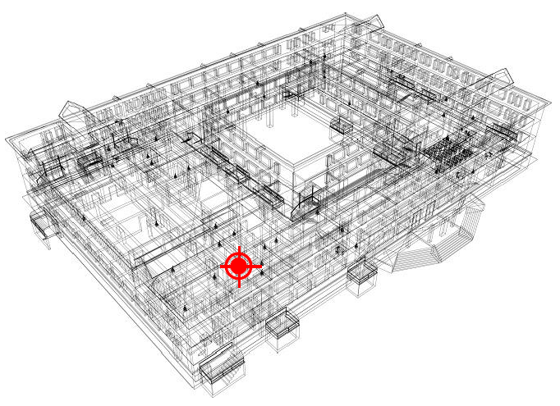
INDOOR WI-FI POSITIONING SYSTEM
IoT Analytics

Slide 2
AGENDA
Our Process
Overview of the Data
Overview of the Analysis
Model Results
Conclusion and Final Observations
IoT Analytics

Slide 3
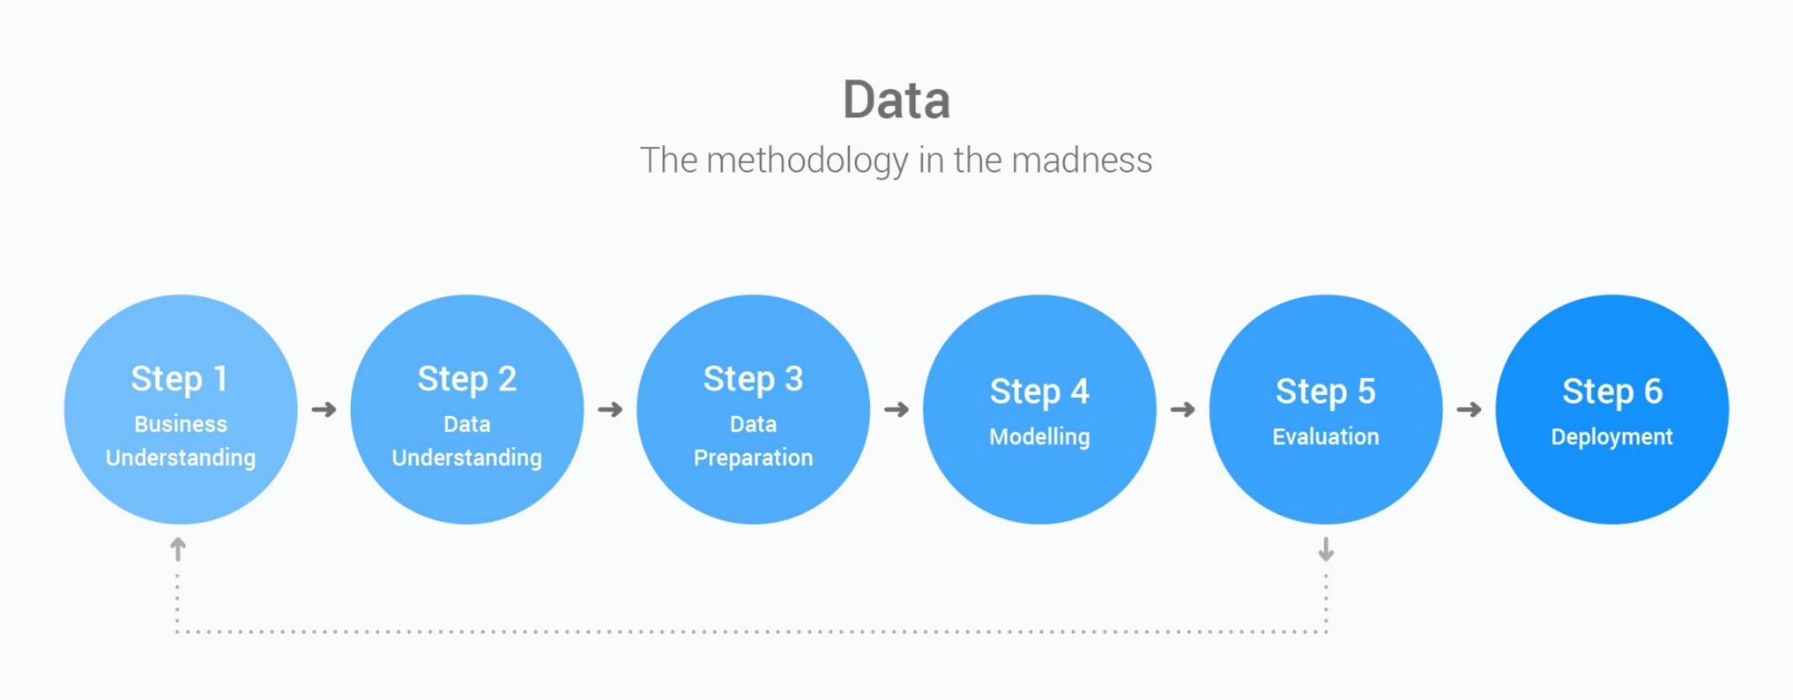
Our Process:
IoT Analytics

Slide 4
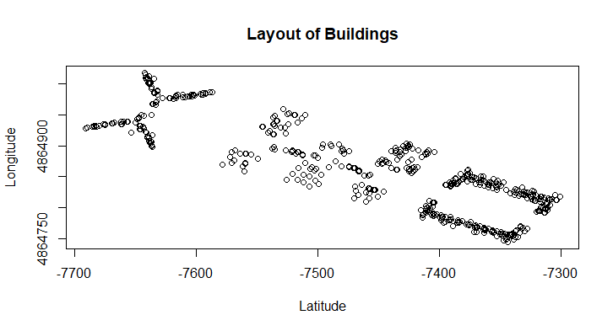
Brief Overview of the Data:
UJIIndoorLoc database
Covers three buildings of Universitat Jaume
Buildings 0 and 1 have 4 floors
Building 2 has 5 floors
21,048 observations with 529 attributes
520 WAPs – wireless access points
Training data set and Validation data set available for analysis
Our goal is to use the WAP readings to determine user location in each building
IoT Analytics

Slide 5
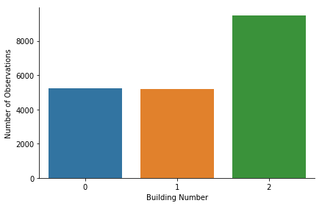
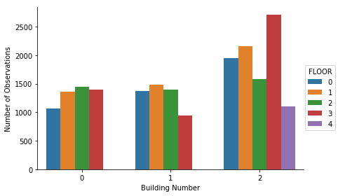
Overview of Analysis:
Observations Per Building
Observations Per Floor
IoT Analytics

Slide 6
Overview of Analysis:
Training set from data source was used for analysis
The set contains 19,937 observations with 529 attributes
Validation set was omitted as it had relatively few samples and did not share all attributes of training set
The SPACEID feature will be predicted
The entire training data set was used in the final analysis
All attributes other than the WAPs and predictor were removed
A 40% sample was created for analysis
This sample was divided into a training set and testing set
Trained 3 different models - RF, KNN, LDA and tested for accuracy and kappa
The model with the highest accuracy was used to predict the user’s location
Sub-setting the data by building did not yield better results
IoT Analytics

Slide 7
Summary of Training Model:
Model | Accuracy | Kappa
KNN | .629 | .623
RF | .712 | .708
LDA | .418 | .410
IoT Analytics

Slide 8
Conclusions and Final Observations:
The model with the best accuracy was RF – Random Forest
Many scenarios were considered and tested
These scenarios generated errors which required extensive research
Leaving in features did not increase accuracy and were thus omitted
Ultimately, using all WAPs and the SPACEID yielded the best result
The model SVR did not handle the data well and was not considered
IoT Analytics

